Slide 1
Titanic Survival Prediction
by
Richard Akinwande

Slide 2
Objective:
The objective of this project is to analyze the Titanic dataset and predict the survival outcome of passengers based on various factors such as age, gender, passenger class, etc.
Data Source:
The dataset used in this project is the Titanic dataset, which contains information about passengers aboard the Titanic, including features such as age, gender, passenger class, fare, and survival status.

Slide 3
WORKFLOW
Exploratory Data Analysis (EDA):
Model Building:
Conclusion:
Data Loading and Exploration:
Results:

Slide 4
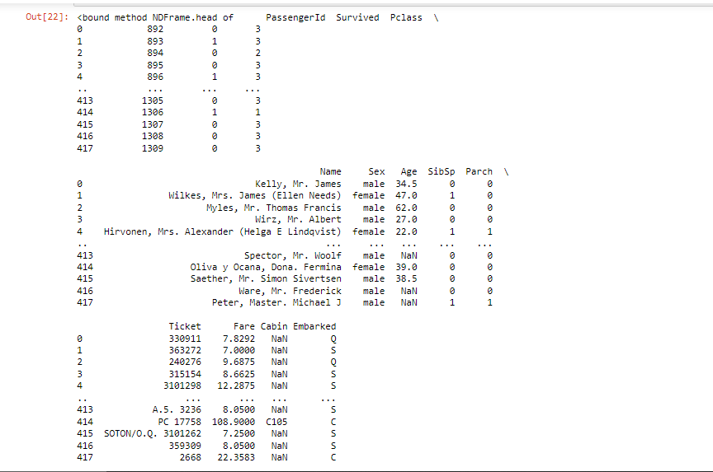
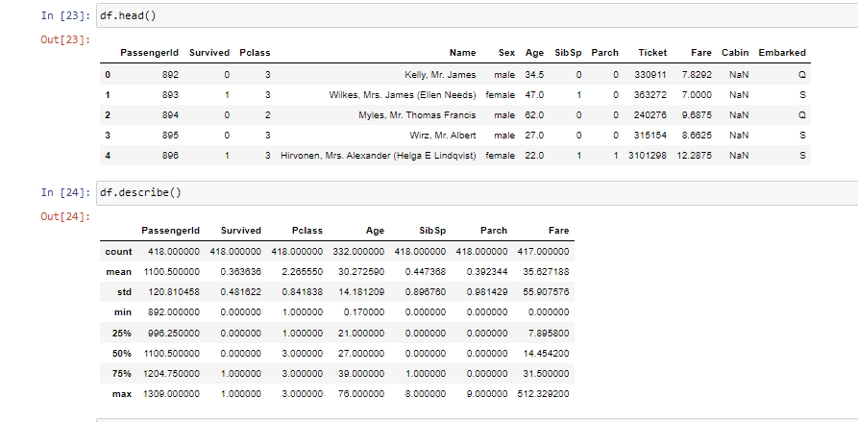
Data Loading and Exploration:
The dataset was loaded into a pandas DataFrame for analysis.
Initial exploration of the dataset was conducted to understand its structure, features, and data types.
A
B
Fig A: Data loading for QC
Fig B: Data Summary Statistics of Numerical Columns

Slide 5
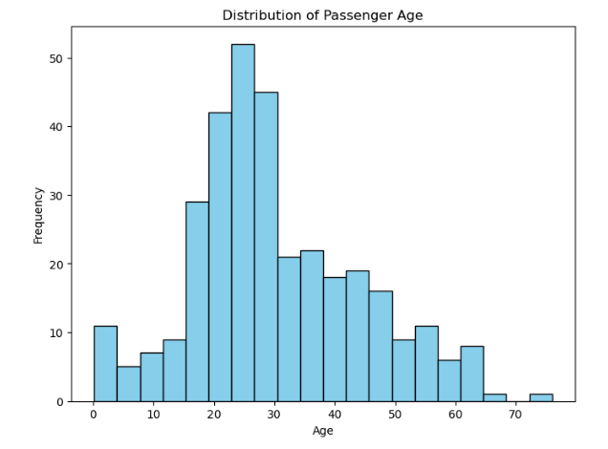
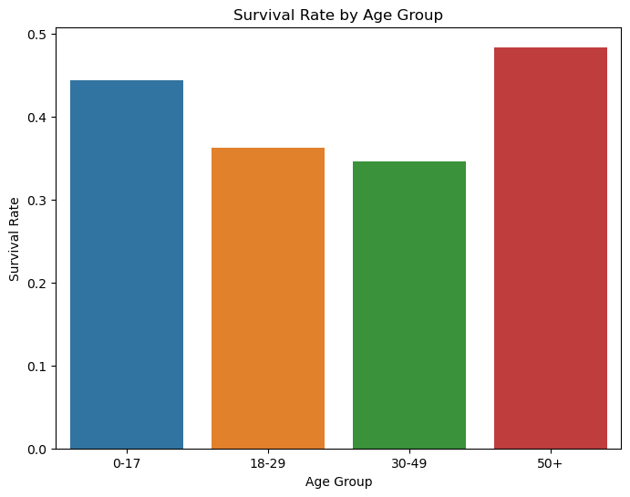
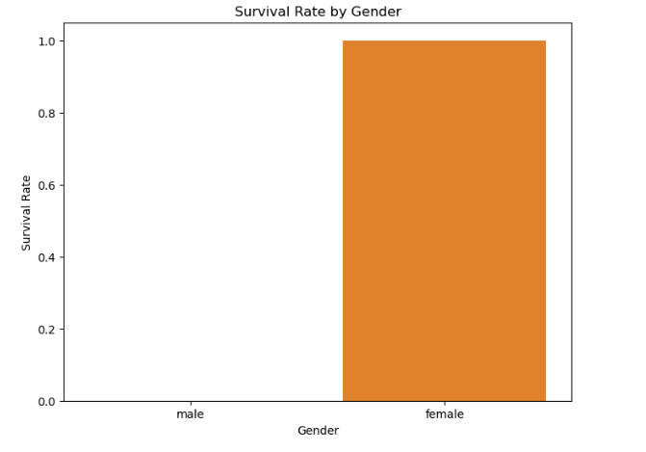
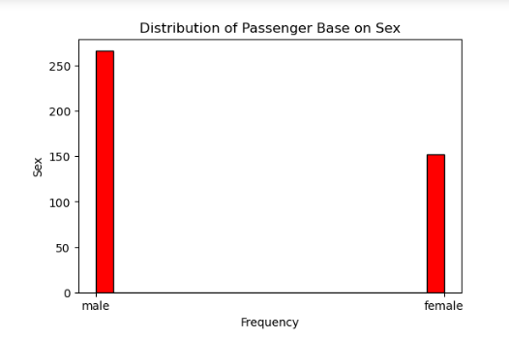
Exploratory Data Analysis (EDA)
Distribution of passenger base on age and sex was visualized using histogram.
Survival rates were calculated and visualized across different categories such as gender, passenger class, and age group.
Correlations between survival and various features were explored using visualizations such as heatmaps, scatter plots, and box plots.
C
E
F
D

Slide 6
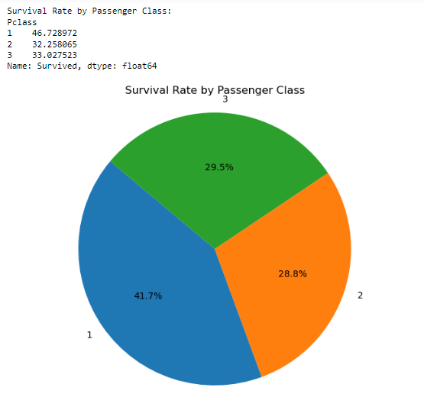
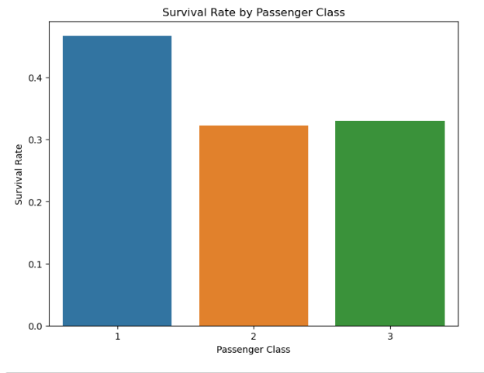
CORRELATION OF SURVIVAL
F
G

Slide 7
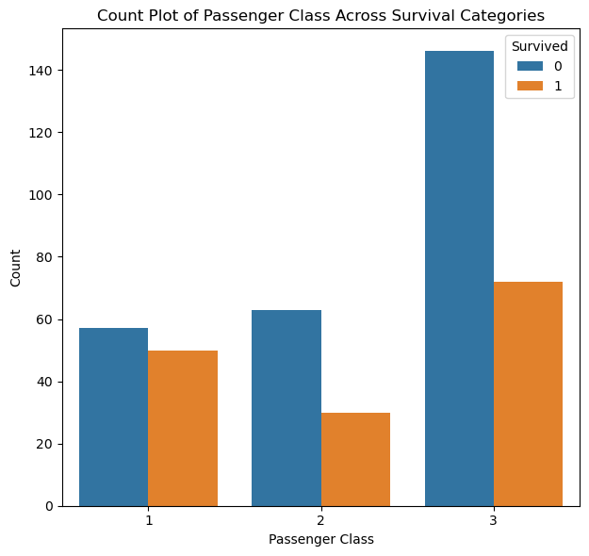
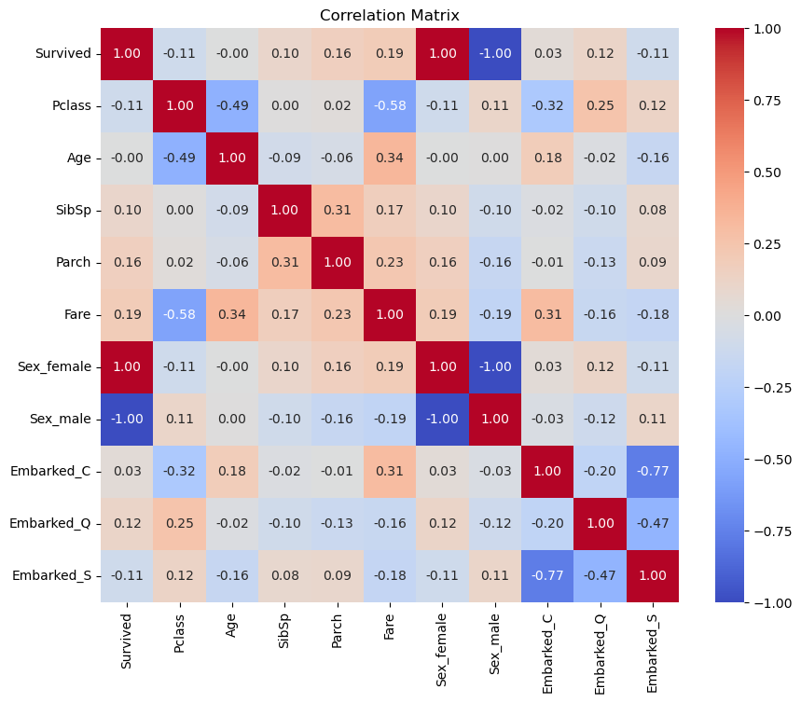
CORRELATION OF SURVIVAL
I
H

Slide 8
RESULTS
CONCLUSION
The project successfully analyzed the Titanic dataset to understand factors influencing survival outcomes.
The most important features affecting survival outcomes were identified through feature importance analysis.
The distribution of passenger base on age and gender were displayed in fig C & D
The result shows that all female passenger survived and majority of those that survived were the age group of 0-17 and 50+
The Titanic Survival Prediction project demonstrates the application of data analysis and machine learning techniques to derive insights from historical data and make predictions about survival outcomes. By understanding the factors influencing survival, it contributes to our understanding of the tragic event and helps in developing strategies for future disaster preparedness.

